Slide 1




Software Development Project –II
ECE-2200
HOSPITAL MANAGEMENT SYSTEM
Presented By,
Name : Promit Biswas
Roll : 1810039
Dept. : ECE

Slide 2


FRAMEWORK & LANGUAGES:
HTML
CSS
Bootstrap
Javascript
Django
PROGRAMMING LANGUAGES
&
Tools
Tools & Software:
Visual Studio Code (For Editing the Code)
Google Chrome (For Running the Server)

Slide 3


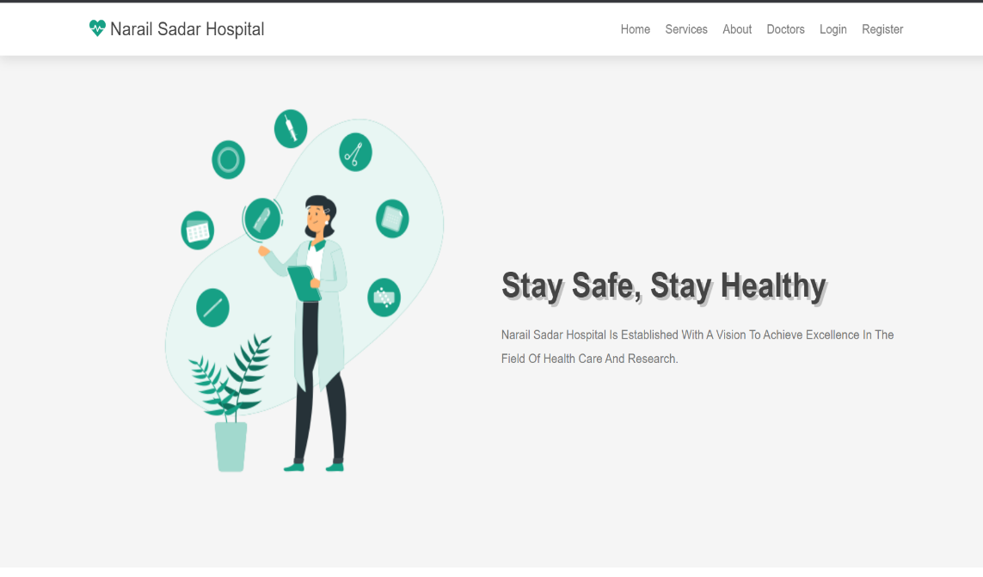
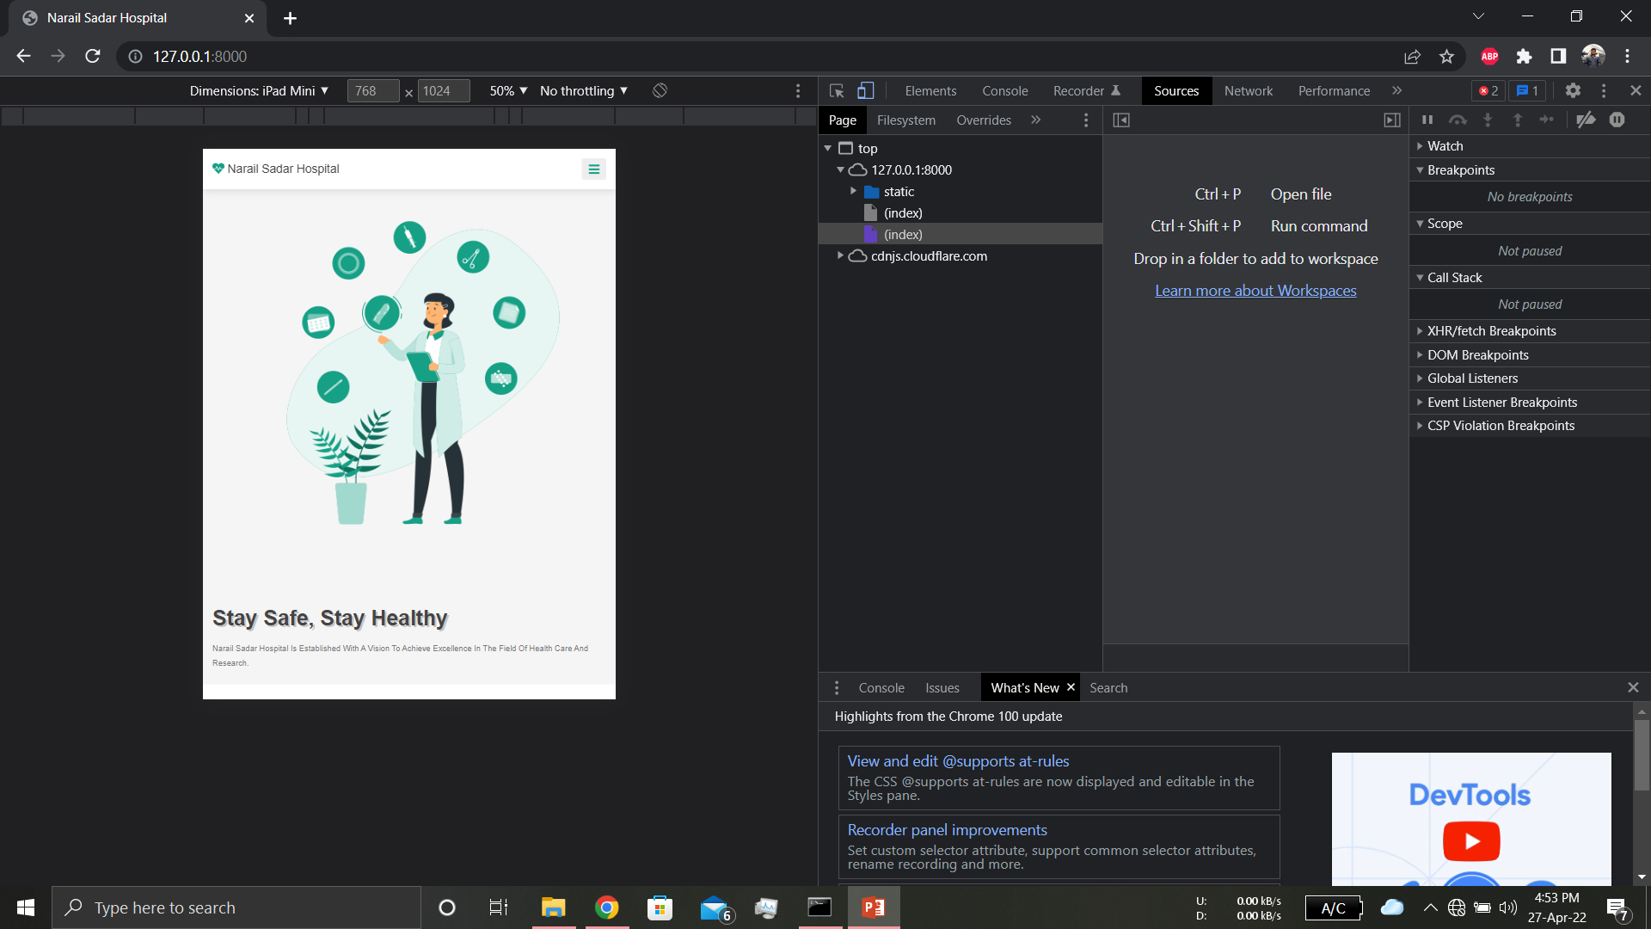
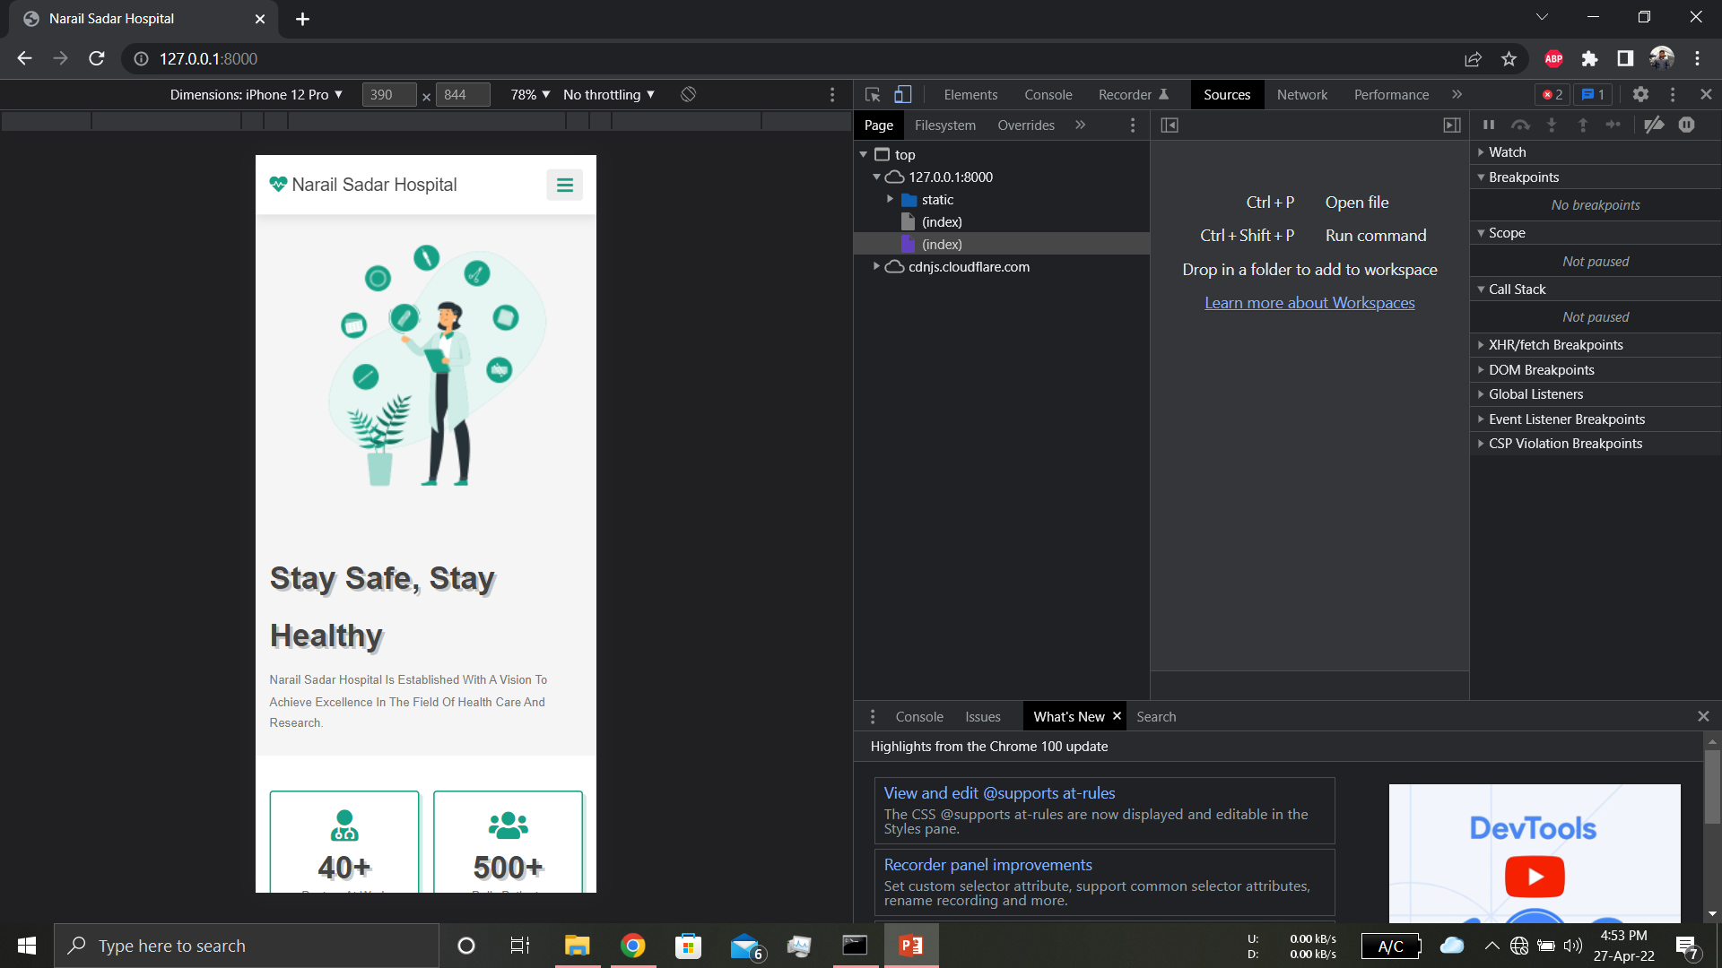


Features
Fully Responsive
For Tablet
For Mobile
For PC

Slide 4
Features
1
Registration is done by Email Verification. Without email Verification no user can Login
2
Only Admin can add Doctor and doctor can change password by himself.
3
Admin can see doctor patients and appointment and delete users
Doctor can prescribe and see his upcoming and previous appointments.
4
5
If user forget his password user can change his password by submitting email.
6
Page has pagination system and save that database file into clipboard, pdf and more.
7
Admin, doctor and patient can logout successfully.

Slide 5



Model
There are Three Models in this Project
Admin Model
Patient Model
Doctor Model

Slide 6
ADMIN MODEL
1. Admin Home:
4. View Patients
Admin Home
Here Admin can see the first page after a successful Login. Here he can see a message having of Welcome admin and his name.
Here admin can find out the patient’s information’s like ‘View Doctors’ page. Admin can check how many patients are successfully registered.
Add Doctor
2. Add Doctor:
5. Upcoming Appointments:
View Doctor
Here Admin can add doctors with one doctors full information’s. By which a doctor can login with email and primary password given by admin.
Here Admin can check how many appointments are available to be done and which doctor need to check patients.
View Patient
Upcoming Appointments
3. View Doctors:
6. Previous Appointments:
Here Admin can check how many doctor are available in that hospital and check their information’s
Here Admin can find out the previous dated appointments with Prescriptions which is given by a doctor .
Previous Appointments
Logout

Slide 7


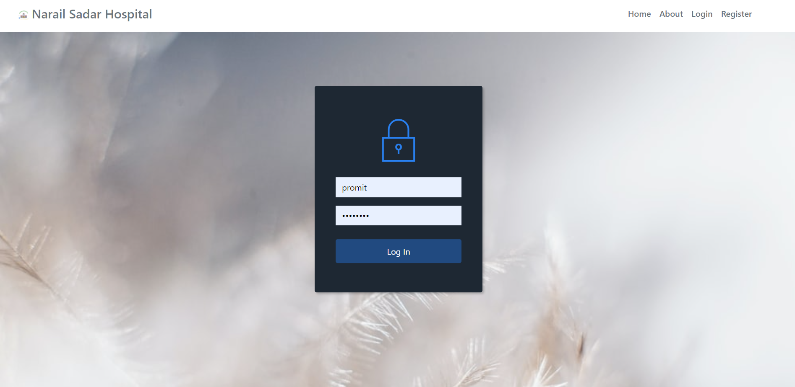
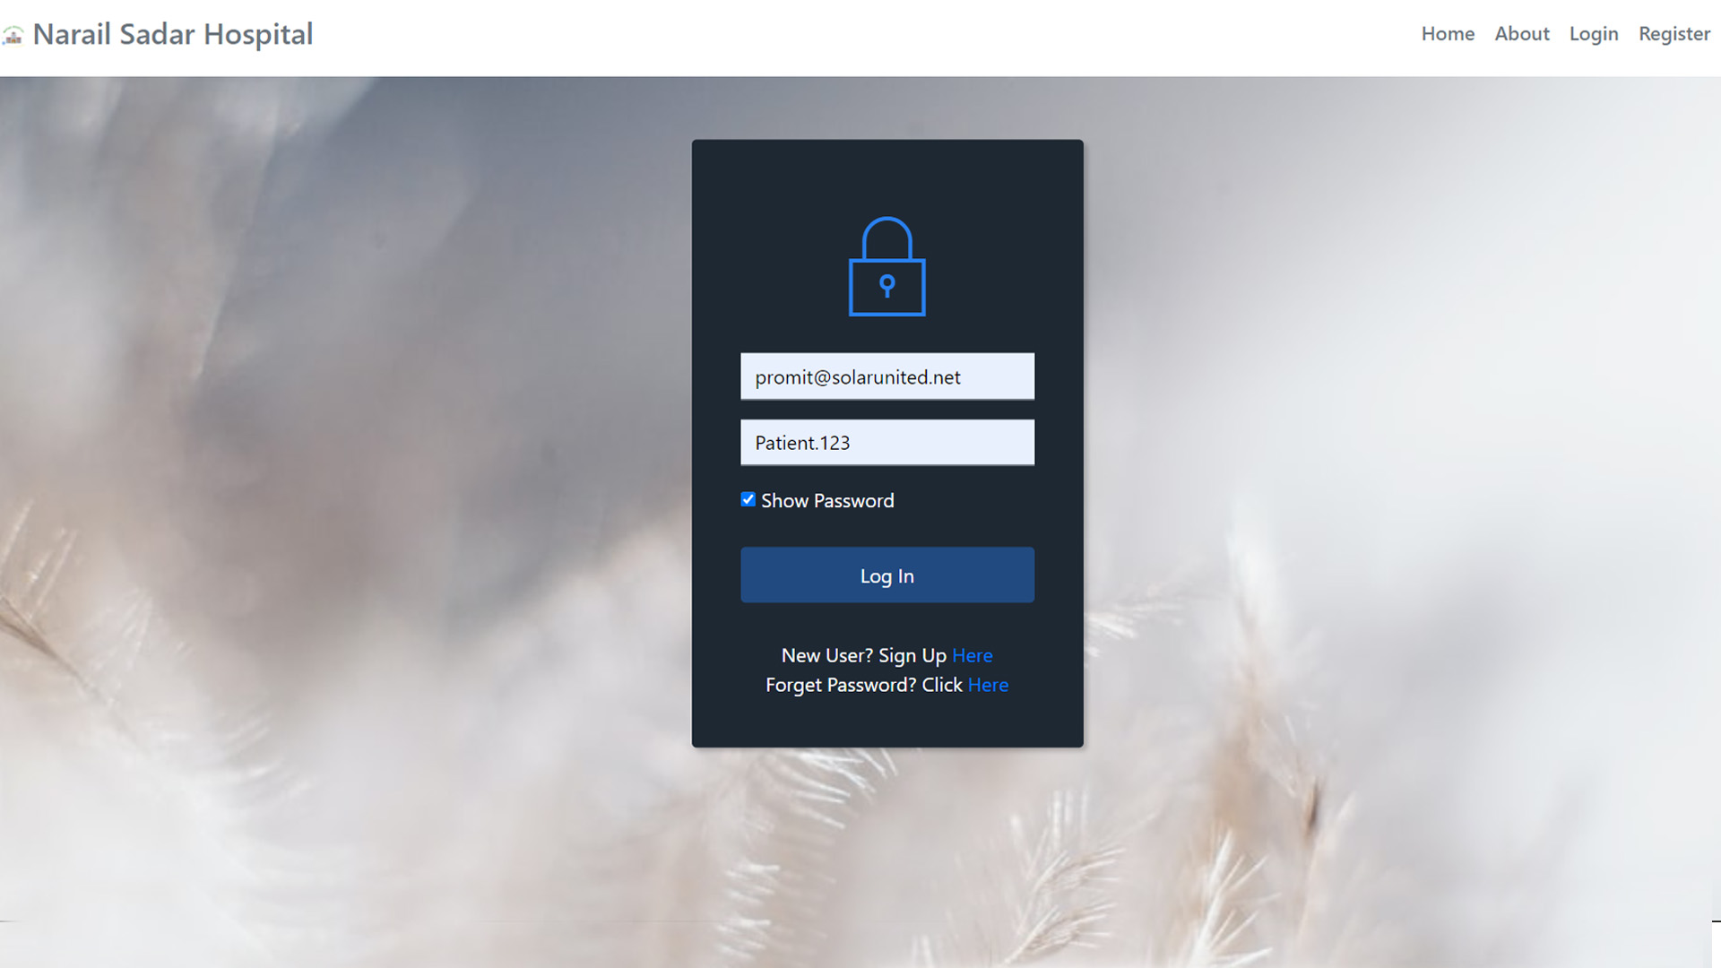
ADMIN
LOGIN

Slide 8
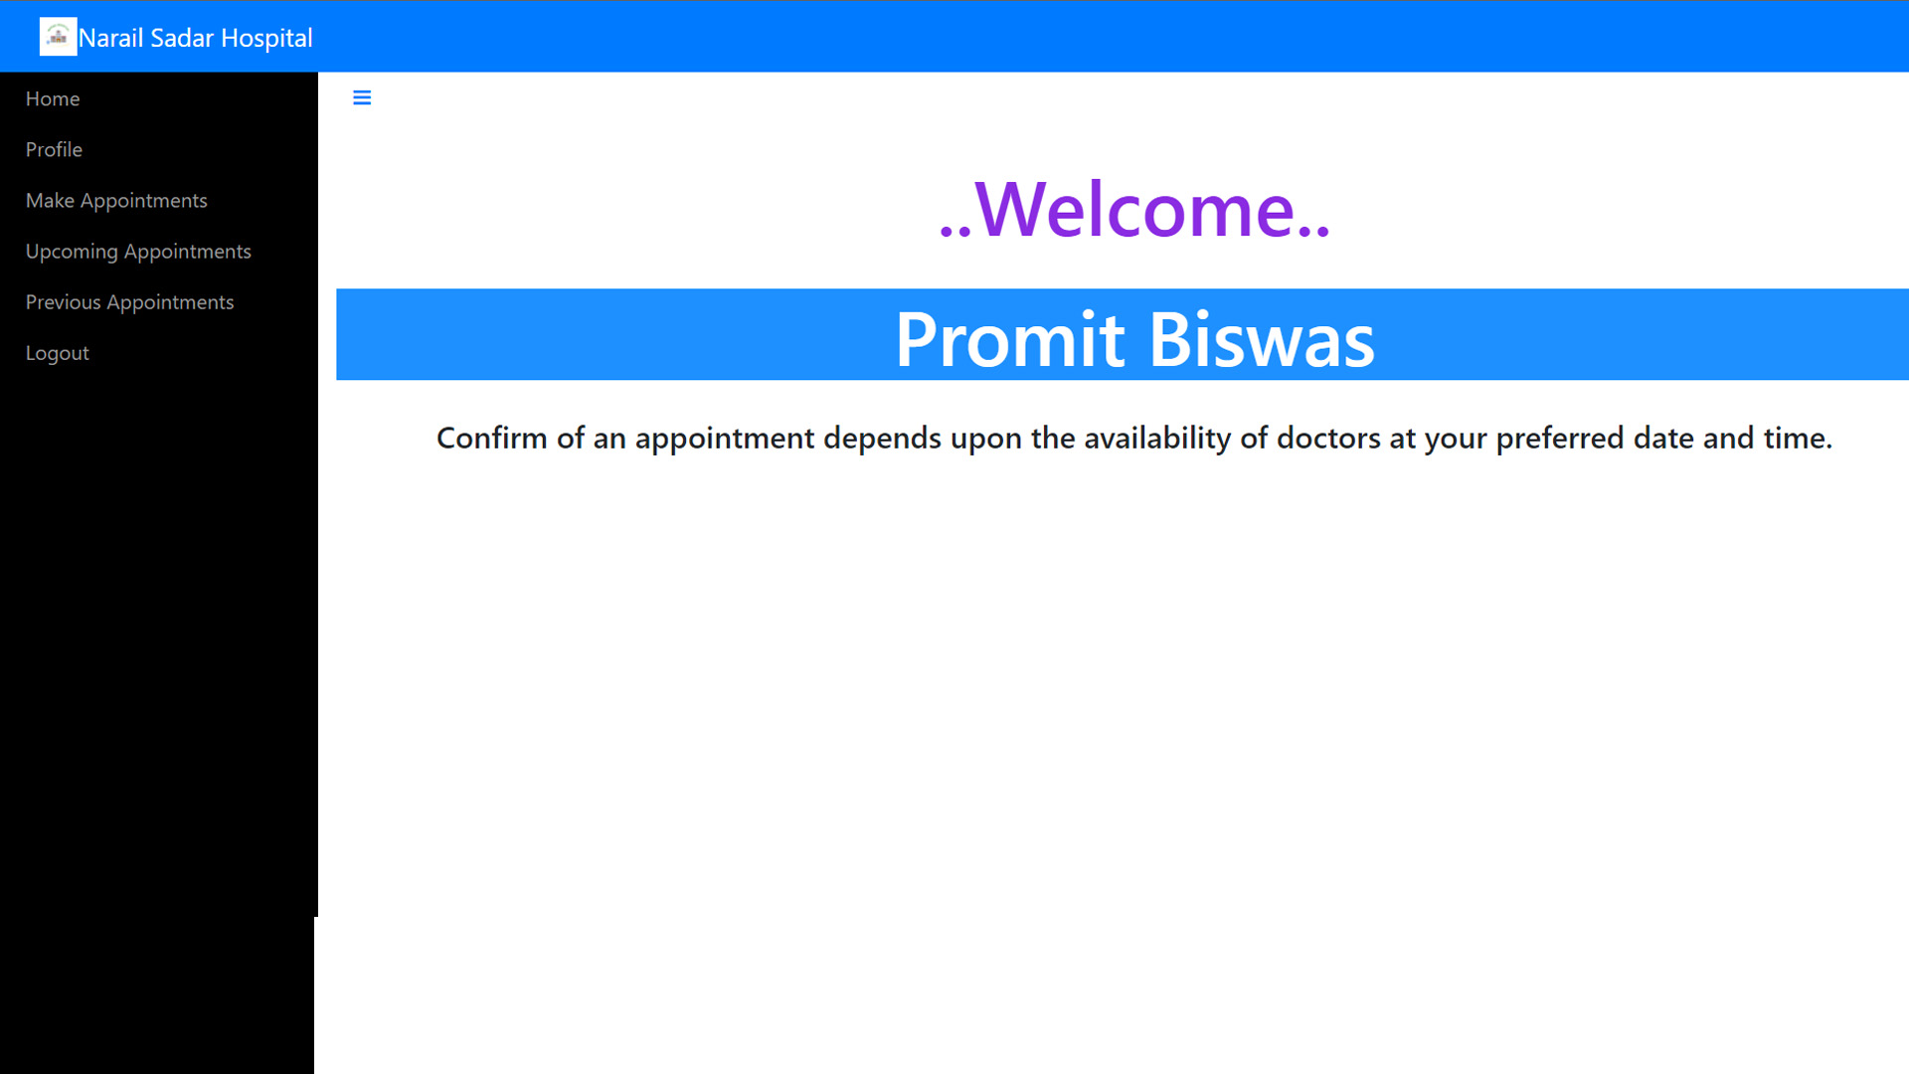
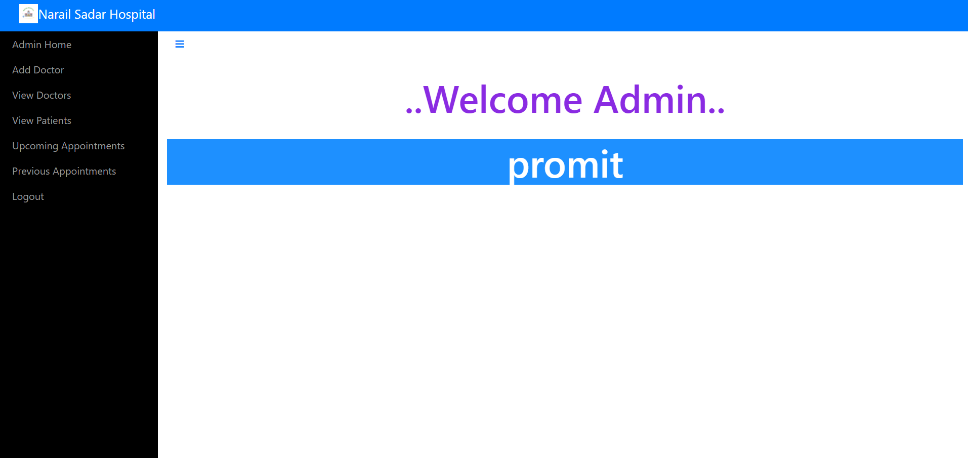
ADMIN
After Successful Login
HOME PAGE

Slide 9

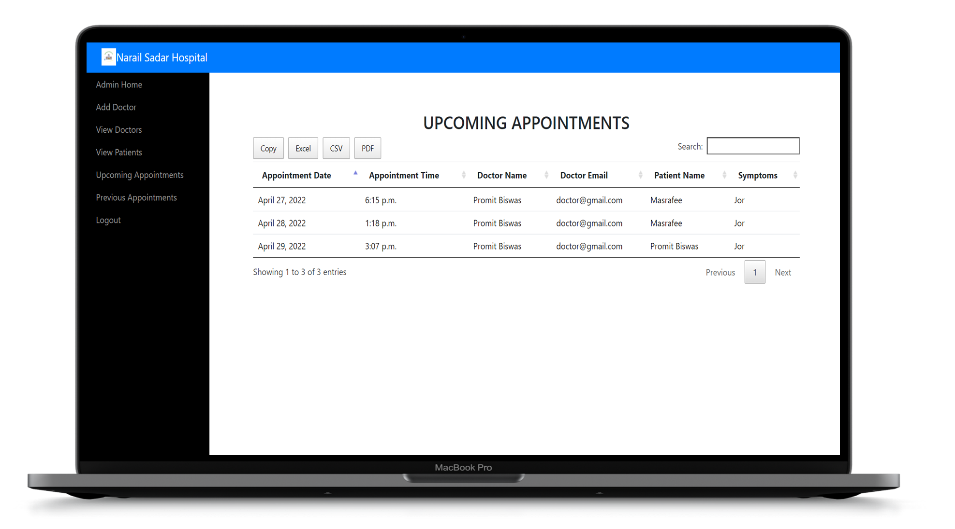
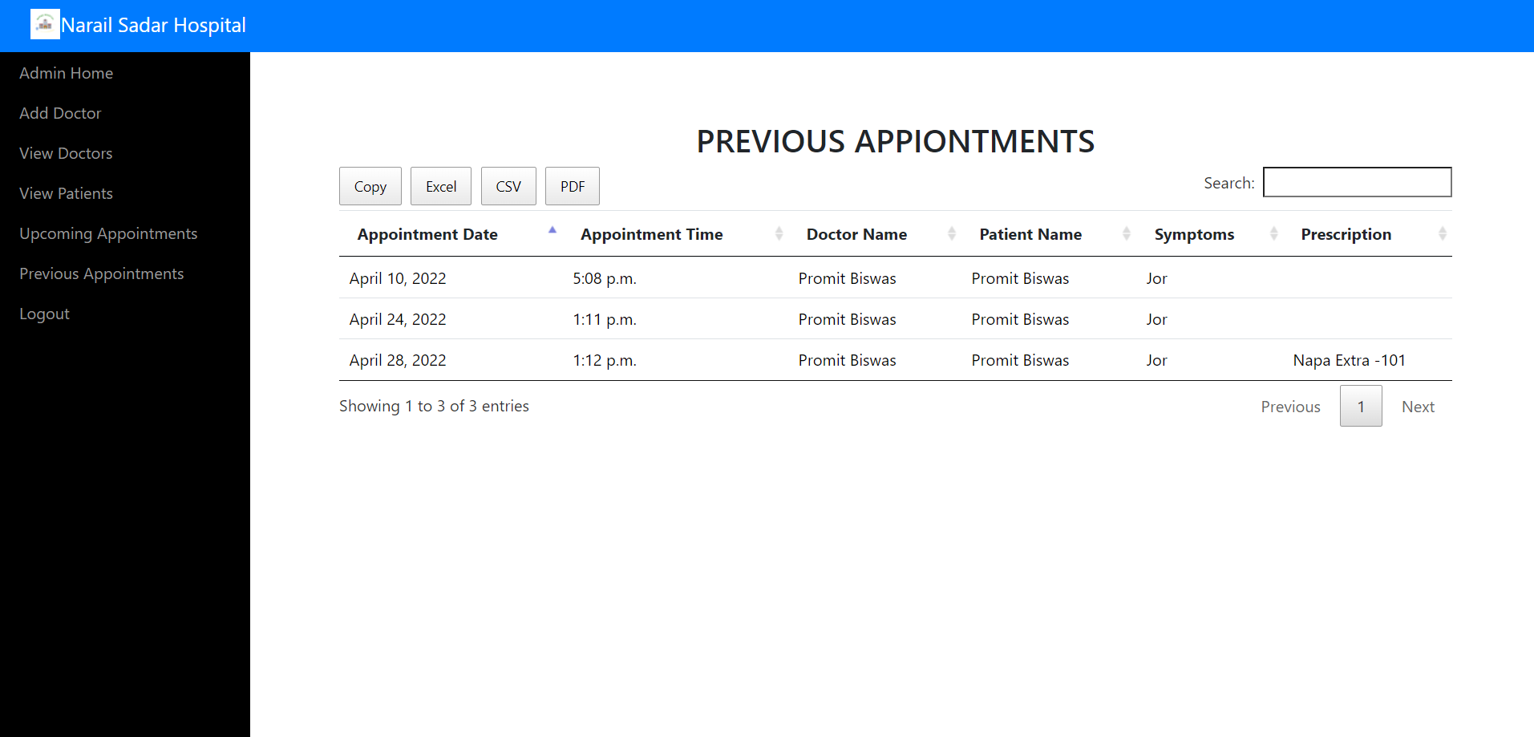
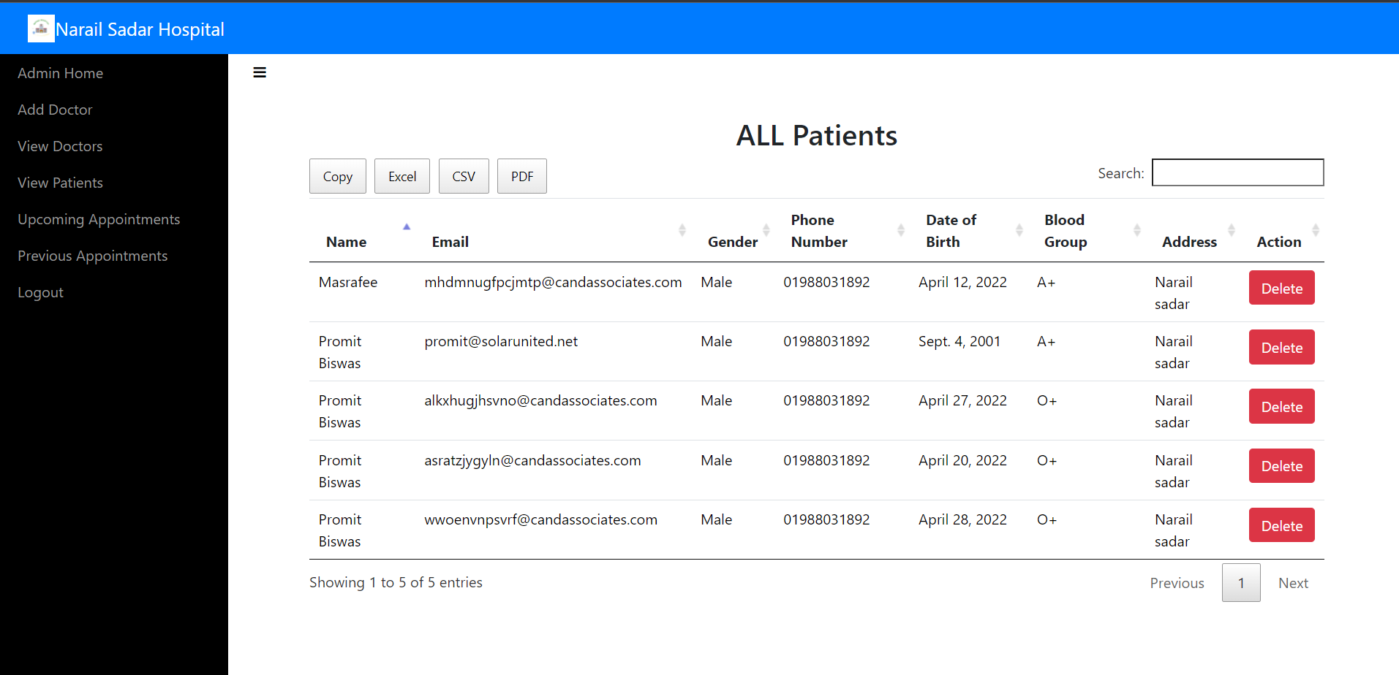
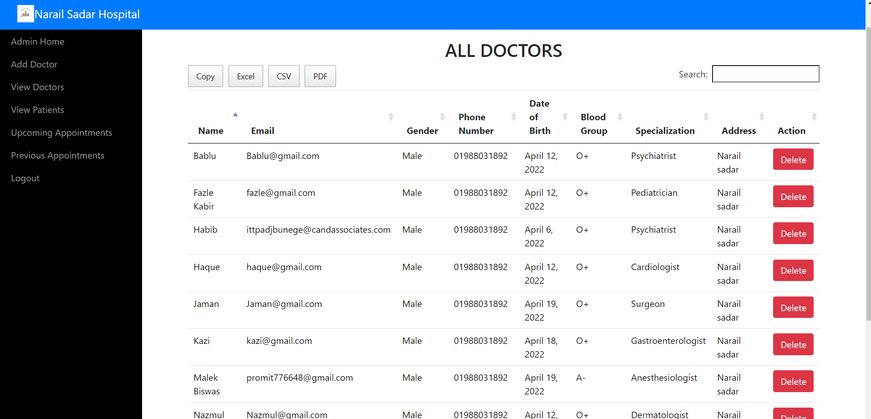
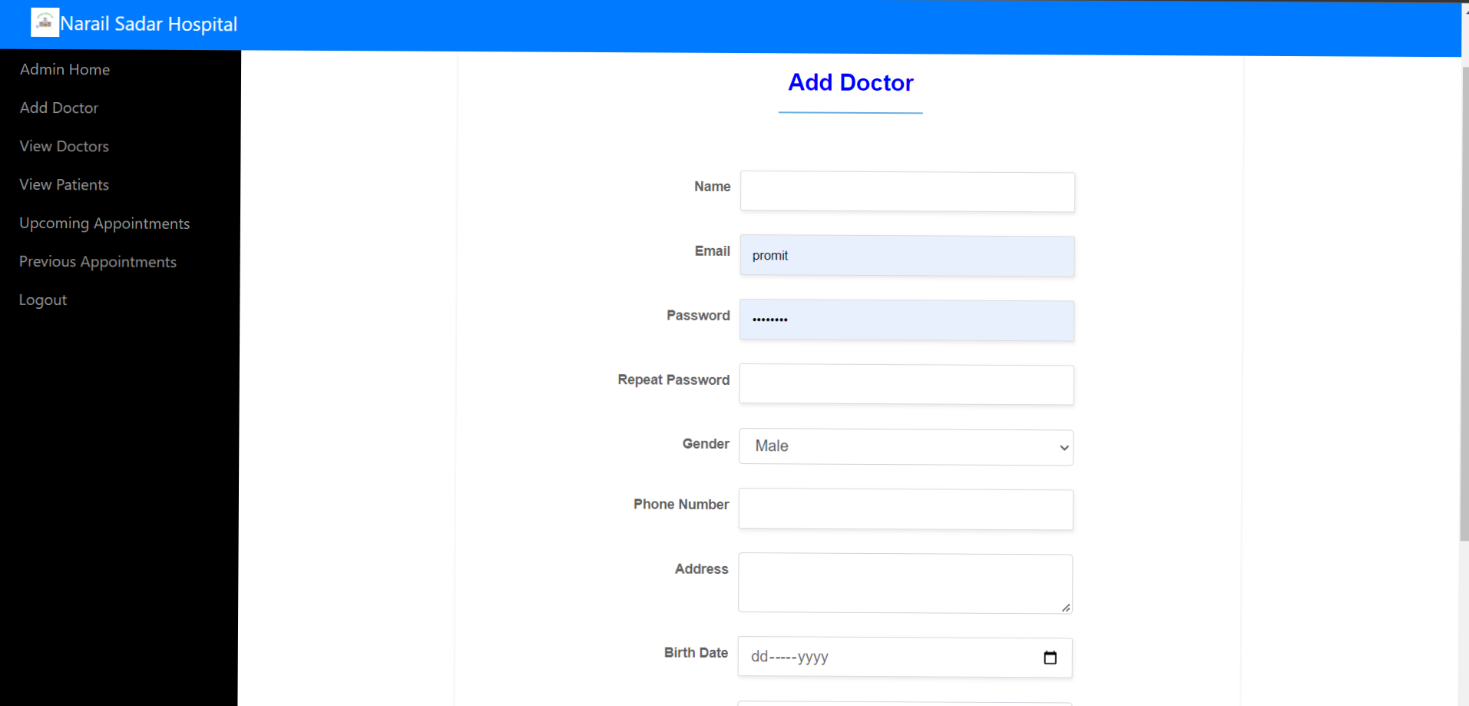
ADMIN MODEL

Slide 10
PATIENT MODEL
1. Patient Home
Patient can see a welcoming message through this page.
1
2. Patient’s Profile
2
Patient can check his profile from this page and this page is read only.
3
Patient can make an appointment from this page at his desired time and date
3. Make an Appointment
Patient
Patient can see his upcoming appointments from this page.
4
4. Upcoming Appointment
5
Patient can see his previous appointments from this page.
5. Previous Appointments
6
Patient can logout from all of his activity from the patients Model.
6. Logout

Slide 11
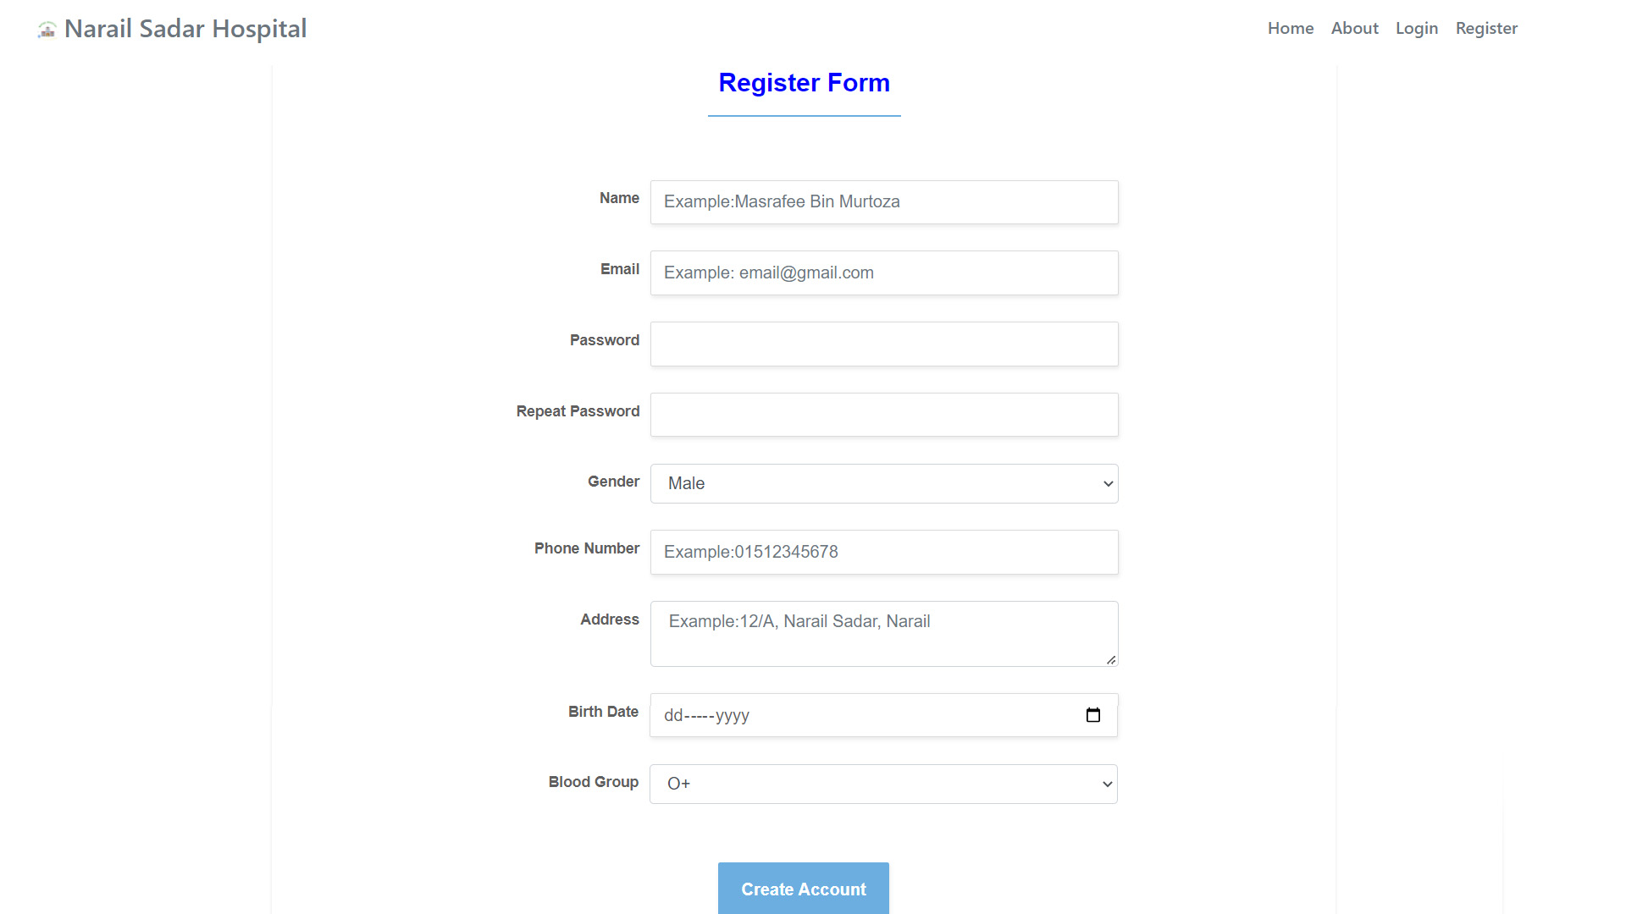
PATIENT
REGISTRATION

Slide 12

PATIENT
LOGIN

Slide 13
PATIENT
After Successful Login
HOME PAGE

Slide 14
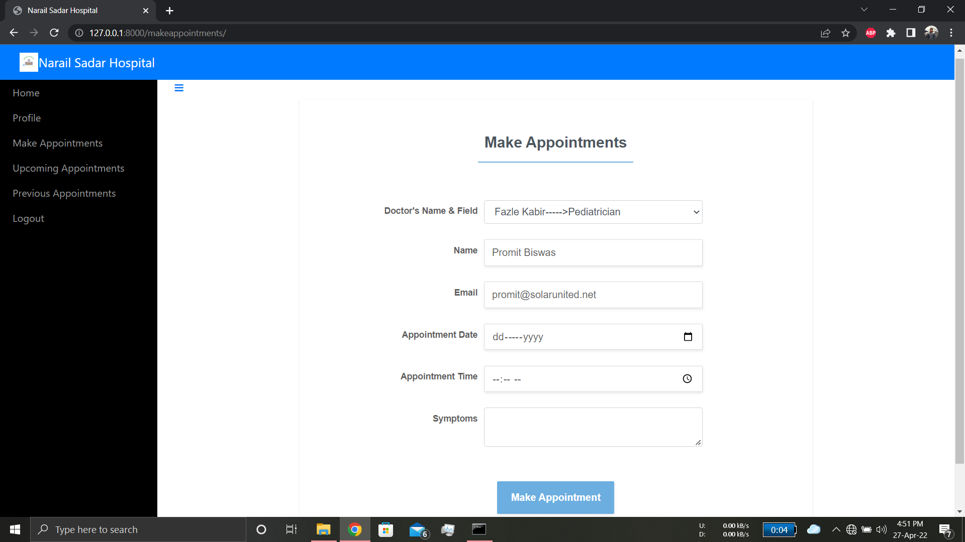
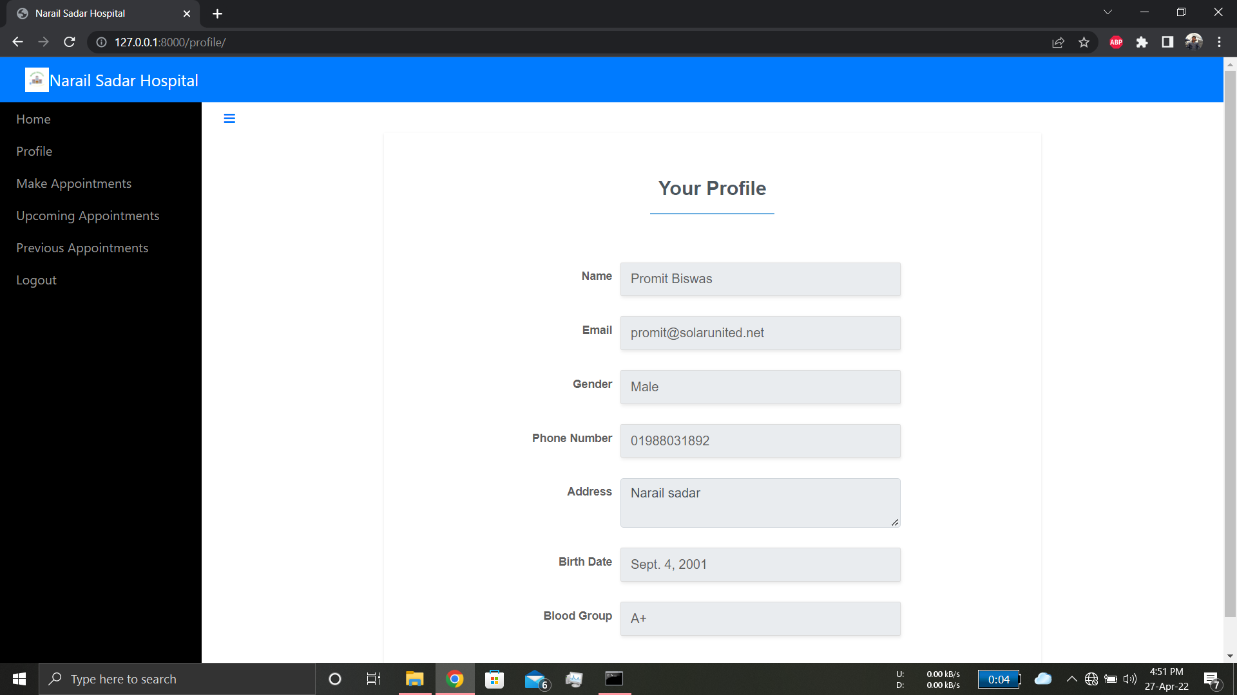
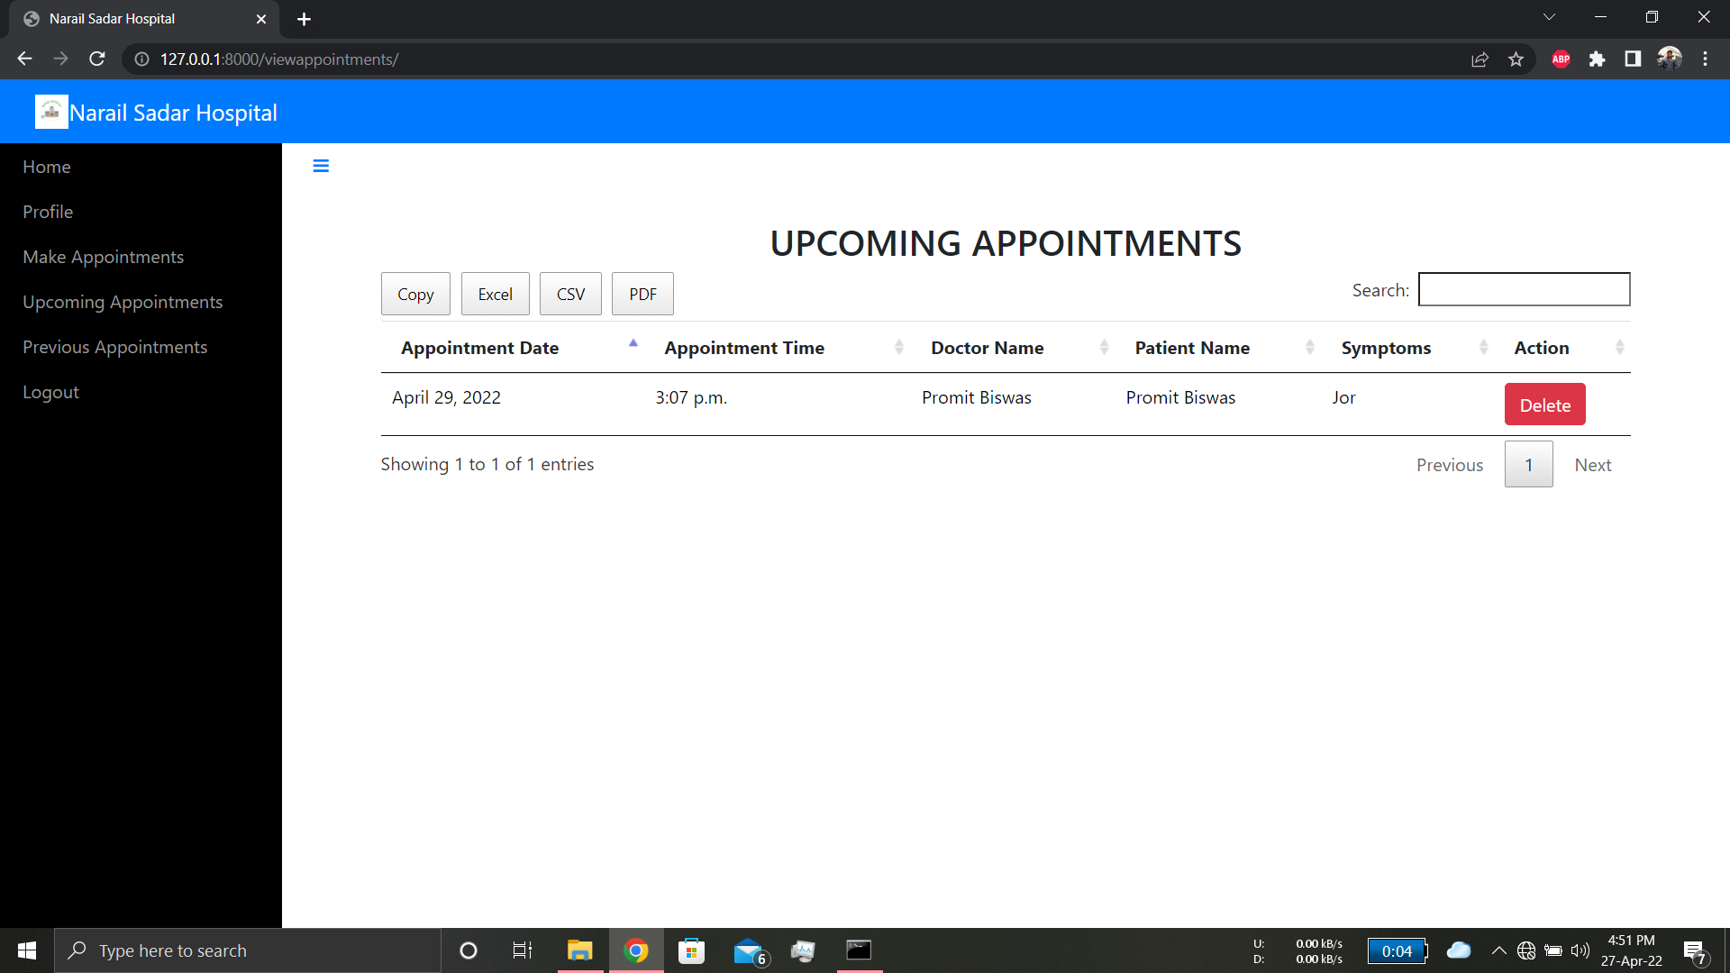
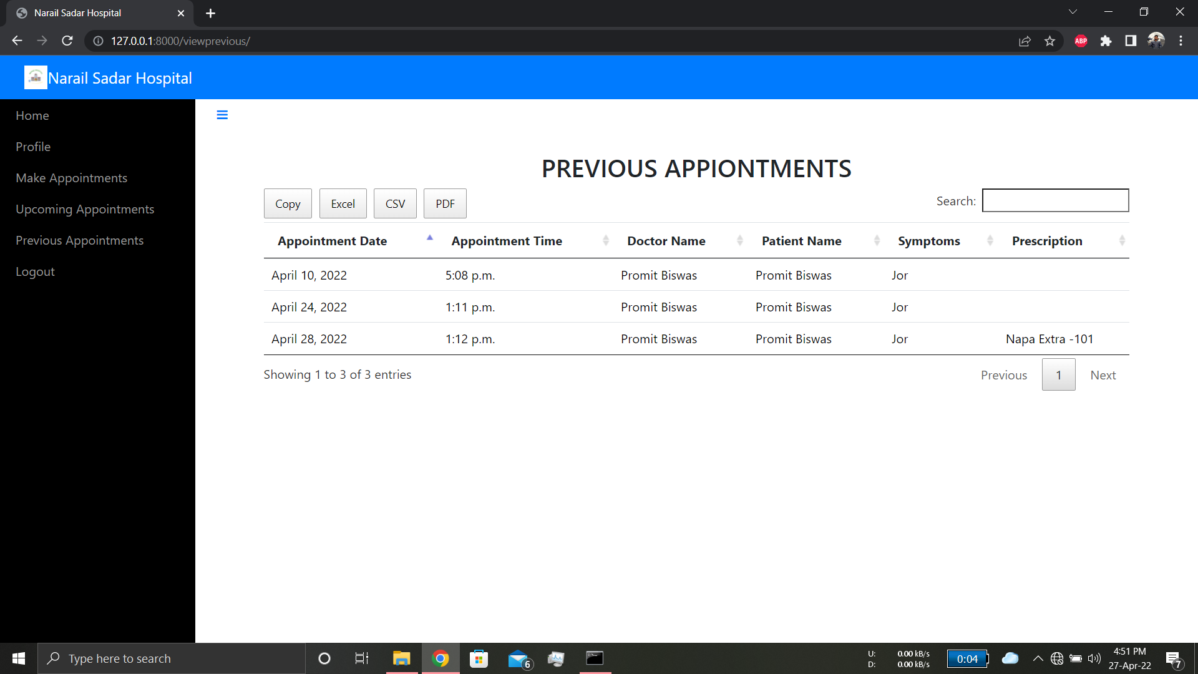
PATIENT MODEL

Slide 15
DOCTOR MODEL
Home
Doctor can see a welcoming message through this page.
Doctor’s Home
Profile
Doctor’s Profile
Doctor can check his profile from this page and this page is read only.
Upcoming
Doctor can see his upcoming appointments from this page.
Upcoming Appointments
Previous
Previous Appointments
Doctor can see his previous appointments from this page.
Logout
Logout
Doctor can logout from all of his activity from the Doctors Model.

Slide 16
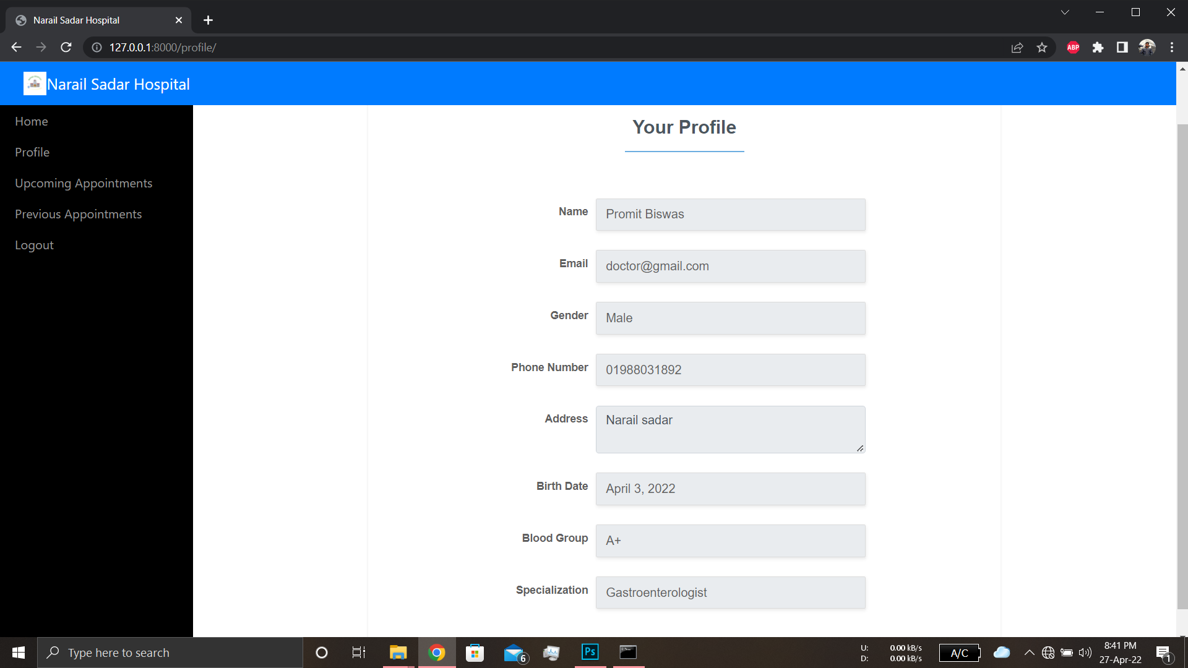
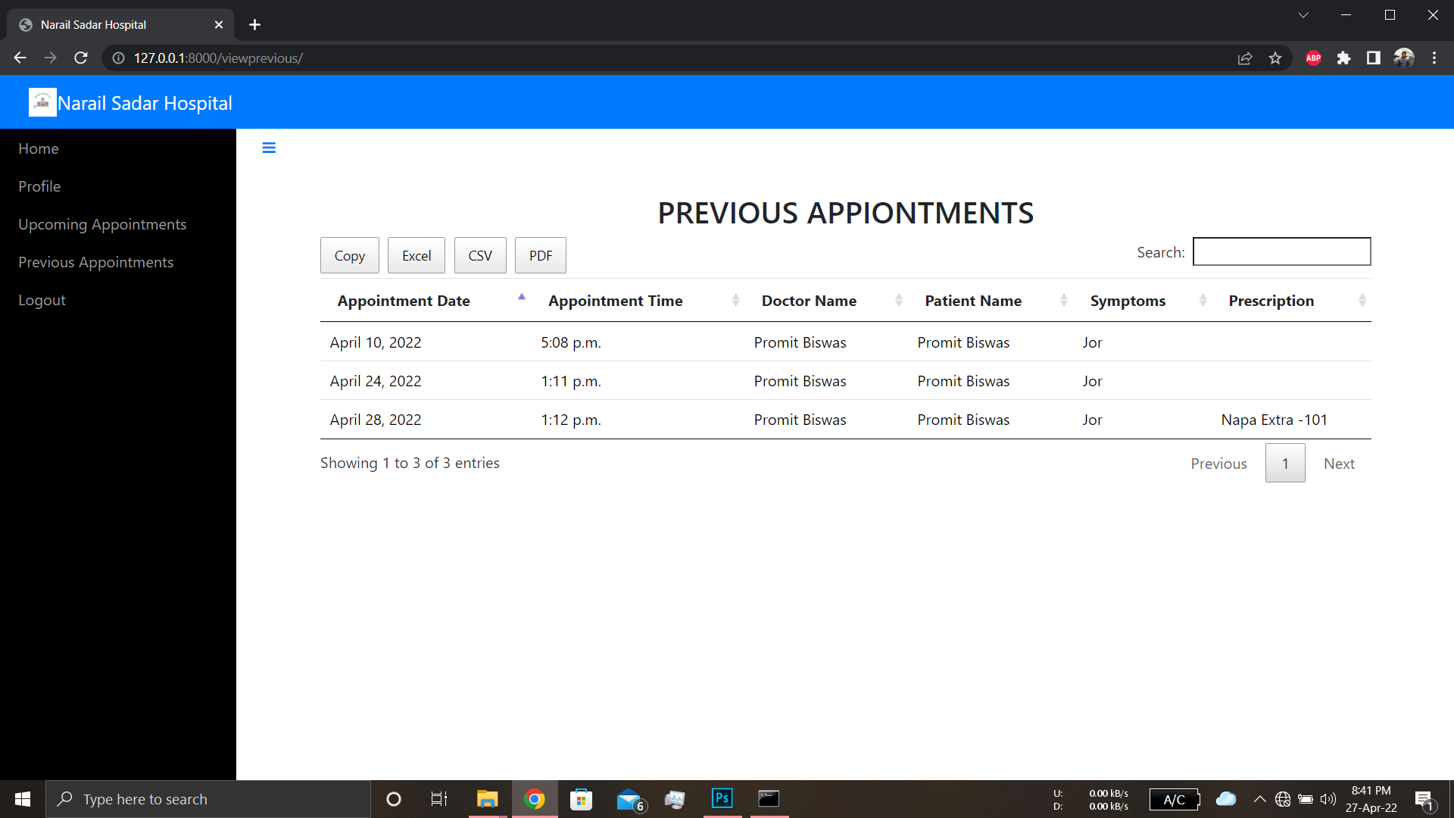
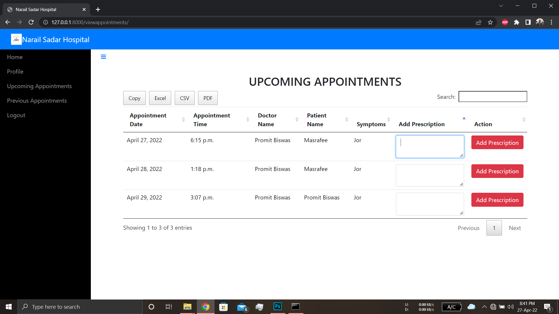
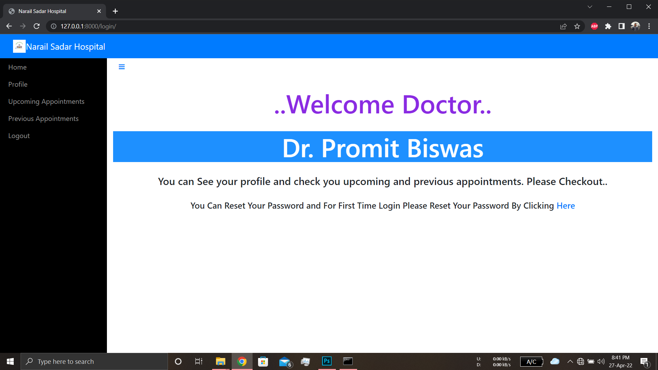
DOCTOR MODEL

Slide 17
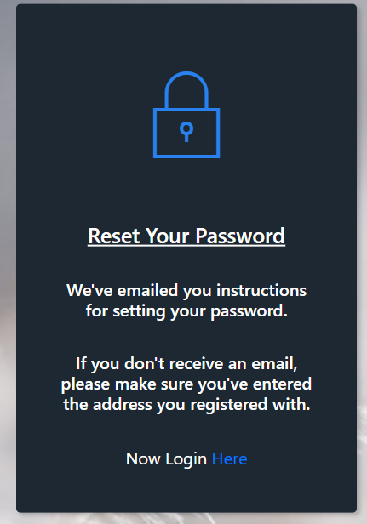
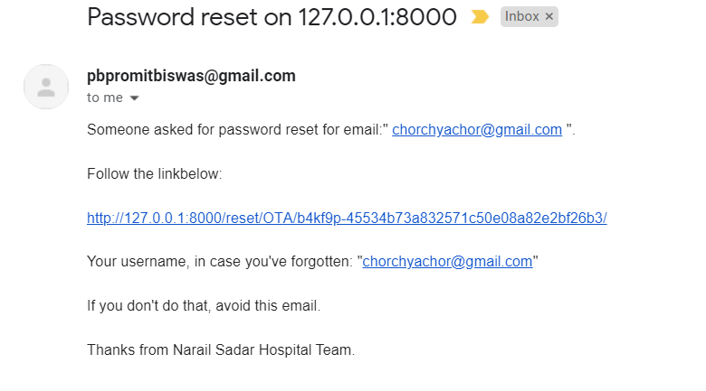
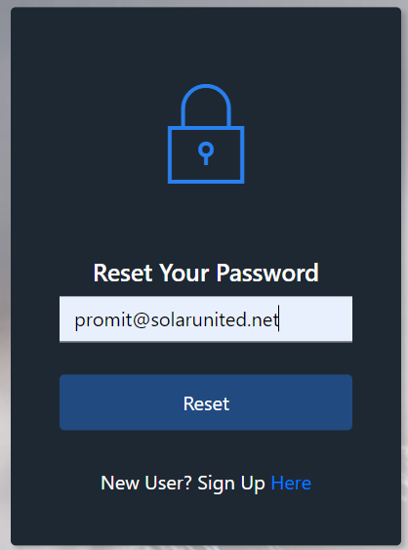
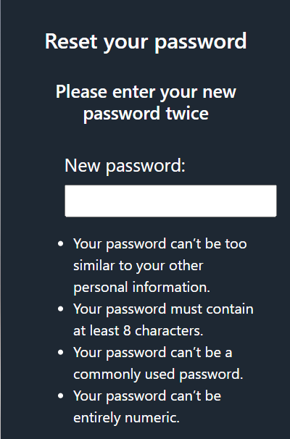
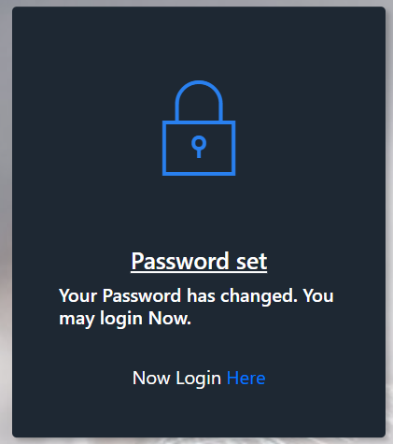
Working Principle of FORGET PASSWORD

Slide 18
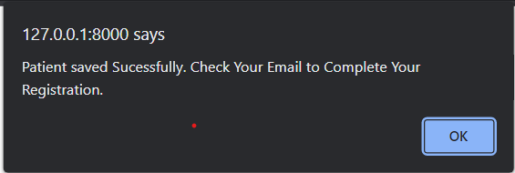
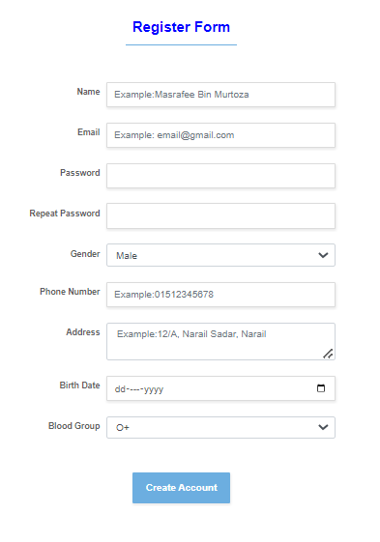
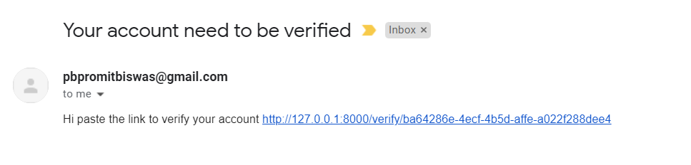
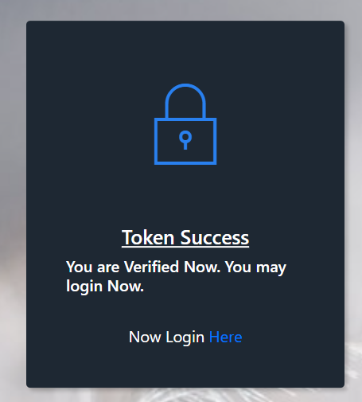
Working Principle of REGISTRATION

Slide 19





HOMEPAGE
HOME
SERVICE
ABOUT
DOCTORS
LOGIN
REGISTER
This page holds the message to the patients about the hospital motto.
This page tells the services that our hospital provides
It includes the history of the hospital and its future goal and present condition
This section tells the best doctors who has appointed for better treatment of patients
This is the page where a user can access to his account and can make an appointment
This is the page where a user can create his profile by submitting his data.

Slide 20
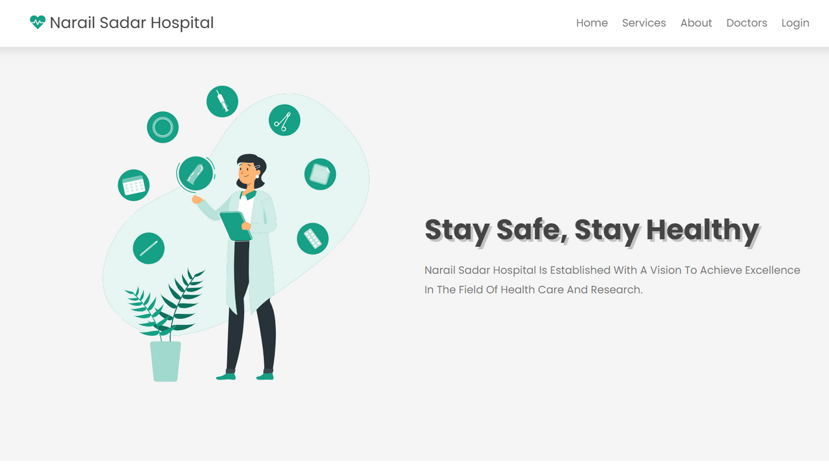
HOMEPAGE
HOME

Slide 21
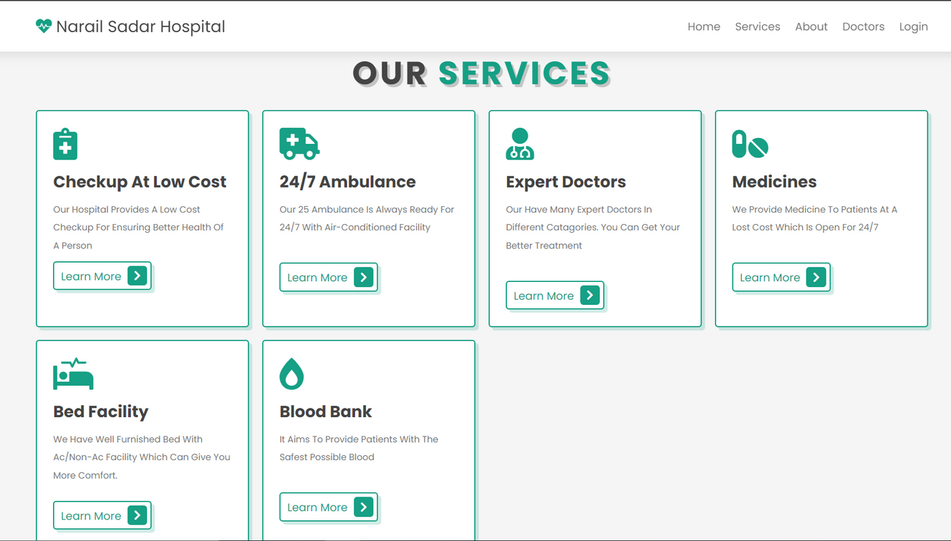
HOMEPAGE
SERVICE

Slide 22
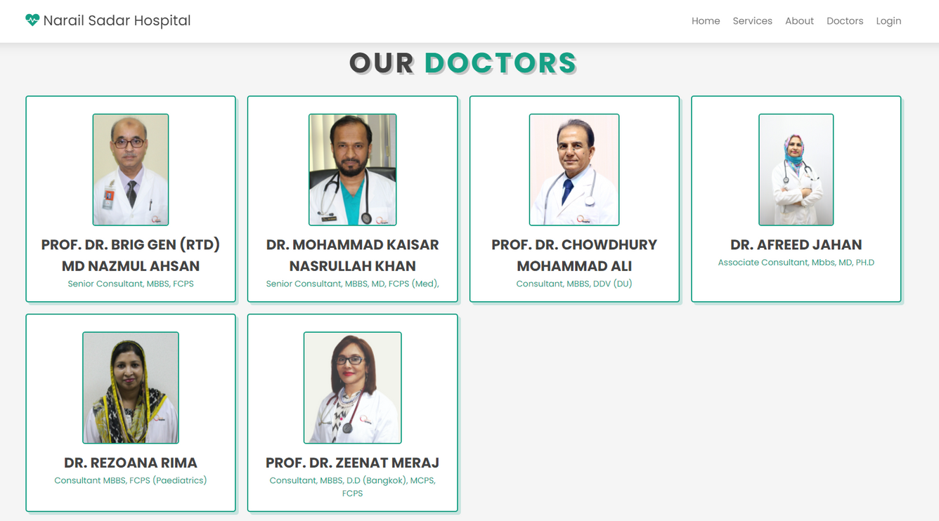
HOMEPAGE
DOCTORS

Slide 23
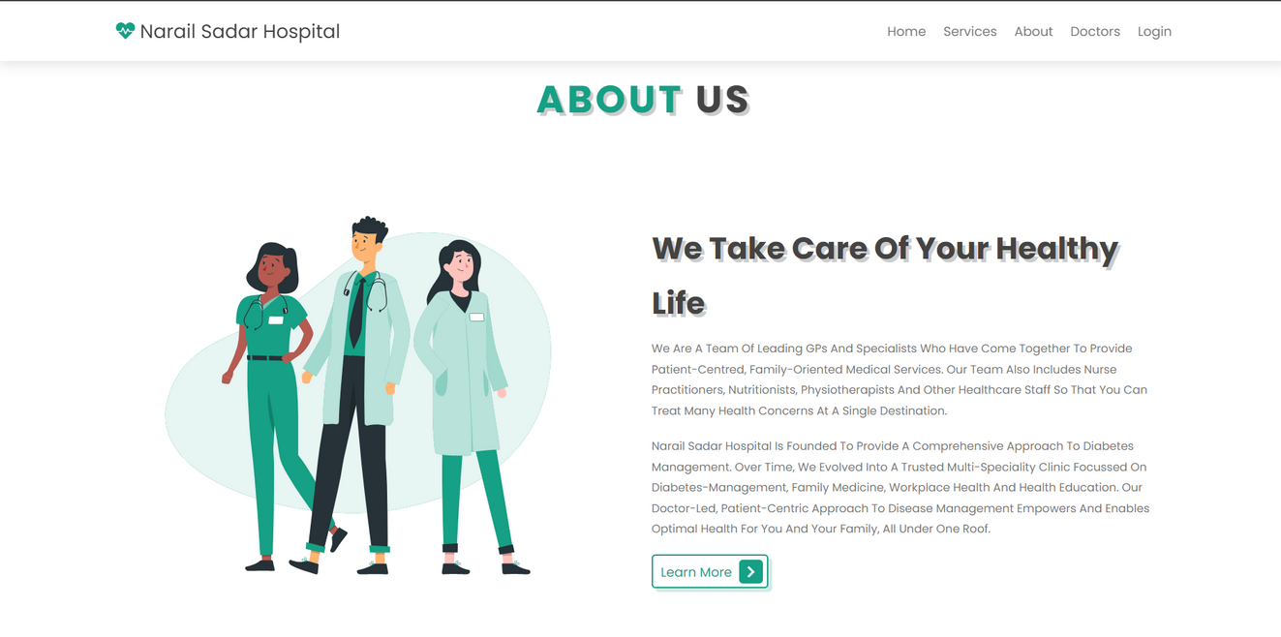
HOMEPAGE
ABOUT

Slide 24
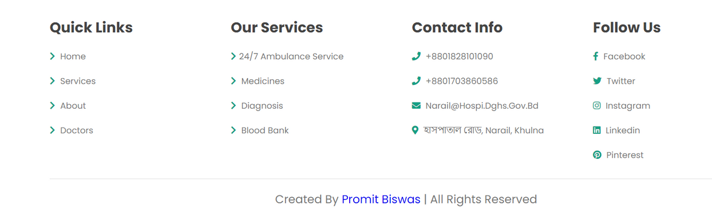
HOMEPAGE
FOOTER

Slide 25
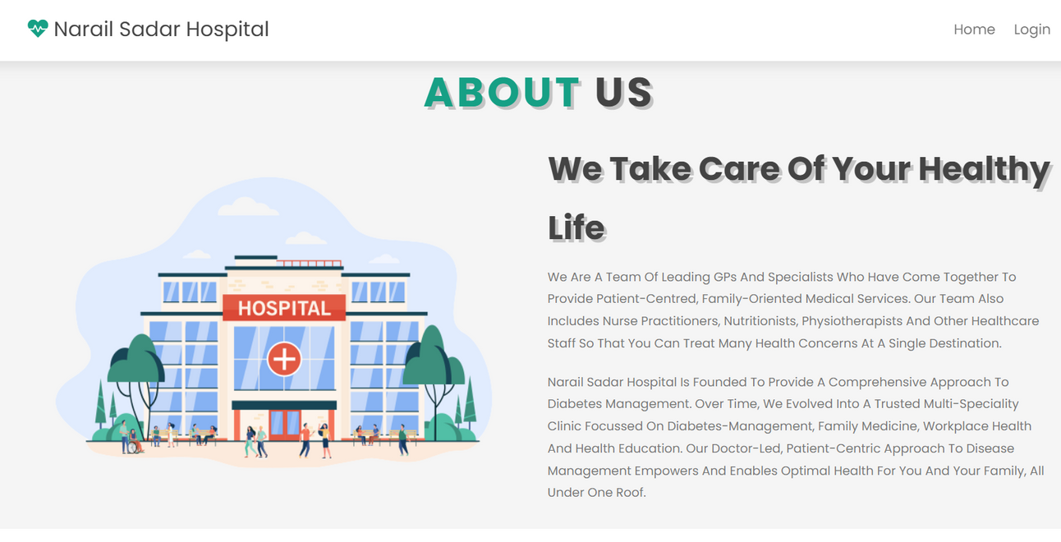
HOMEPAGE
ABOUT

Slide 26


Any Question ?

Slide 27
THANK YOU

